Slide 1
Chapter 4
Requirement Modeling

Slide 2
Systems Analysis Phase Overview
Understand the proposed project
Ensure that it supports business requirements
Build a solid foundation for system development

Slide 3
Systems Analysis Skills
Strong analytical skills
Interpersonal skills

Slide 4
Team-Based Techniques: JAD, RAD, and Agile Methods
Methodologies contain guiding processes for those who are doing project management.

Slide 5
Joint Application Development
Brings users into the development process as active participants
User Involvement (formally or informally) created a successful system
JAD Participants and Roles
Project leader and one or more members
Participants insulated from distractions of day-to-day operations

Slide 6
Joint Application Development (Cont.)
JAD Disadvantages
JAD is more expensive than traditional methods
Can be cumbersome if group is too large
JAD Advantages
JAD allows key users to participate effectively
Users more likely to feel a sense of ownership
Produces a more accurate statement of system requirements

Slide 7
Rapid Application Development
Uses a group approach like JAD
JAD produces a requirements model, RAD produces a new system
Complete methodology
Four-phase life cycle that parallels the traditional SDLC
Reduces cost and development time
Increases the probability of success
Relies on prototyping and user involvement
Prototypes modified based on user input

Slide 8
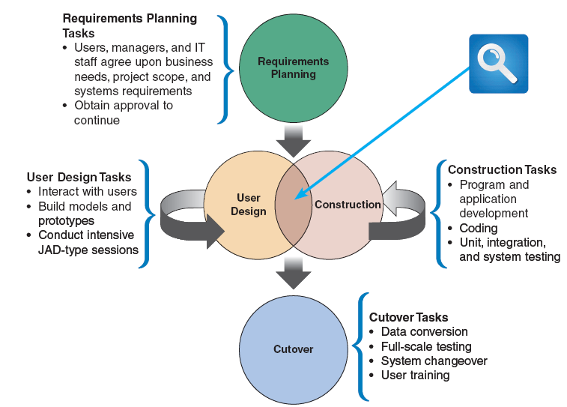
FIGURE 4-5 The four phases of the RAD model are requirements planning, user design, construction, and cutover. Notice the continuous interaction between the user design and construction phases

Slide 9
Requirements Planning
Team agrees on business needs, project scope, constraints, and system requirements
User Design
Users interact with analysts to develop models and prototypes
Construction
Program and application development
Cutover
Management authorization to continue is obtained
A combination of JAD and CASE tools are used
Users understand, modify, and approve a working model
Users can suggest changes as screens or reports are developed
Includes data conversion, testing, changeover to the new system, and user training

Slide 10
Rapid Application Development (Cont.)
RAD Objectives
Cut development time and expenses by involving users in every phase of systems development
Allow the development team to make necessary modifications quickly, as the design evolves
RAD Advantages
Systems developed more quickly with significant cost savings
RAD Disadvantages
Does not emphasize strategic business needs (system might work well in short term but miss long-term objectives)
Less time to develop quality, consistency, and design standards

Slide 11
Agile Methods
Agile methods attempt to develop a system incrementally, by building a series of prototypes and constantly adjusting them to user requirements

Slide 12
Agile Methods (Cont.)
Agile Method Advantages and Disadvantages
Very flexible and efficient in dealing with change
Frequent deliverables constantly validate the project and reduce risk
Team members need a high level of technical and interpersonal skills
May be subject to significant change in scope

Slide 13
Modeling Tools and Techniques
Involves graphical methods and nontechnical language that represent the system at various stages of development
Can use various tools

Slide 14
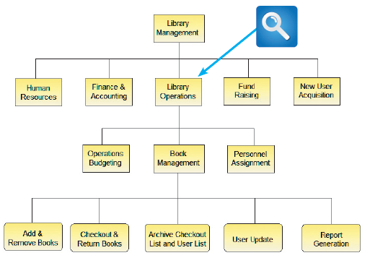
Modeling Tools and Techniques (Cont.)
Functional Decomposition Diagrams
Top-down representation of a function or process
Similar to an organization chart

Slide 15
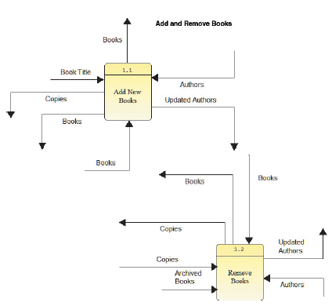
Modeling Tools and Techniques (Cont.)
Data Flow Diagrams
Data flow diagram (DFD)
show how the system stores, processes, and transforms data
Additional levels of information and detail are depicted in other, related DFDs

Slide 16
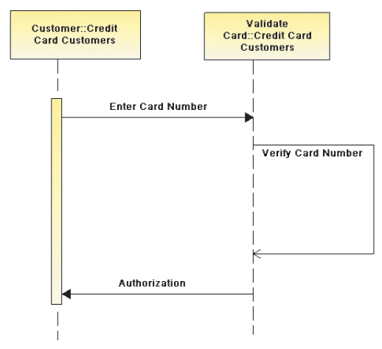
Modeling Tools and Techniques (Cont.)
Sequence Diagrams
Shows the timing of interactions between objects as they occur

Slide 17
System Requirements Checklist
Output Examples
The Web site must report online volume statistics every four hours, and hourly during peak periods
The inventory system must produce a daily report showing the part number, description, quantity on hand, quantity allocated, quantity available, and unit cost of all sorted by part number
The contact management system must generate a daily reminder list for all sales reps
The purchasing system must provide suppliers with up-to-date specifications

Slide 18
System Requirements Checklist (Cont.)
Input Examples
Manufacturing employees must swipe their ID cards into online data collection terminals that record labor costs and calculate production efficiency
The department head must enter overtime hours on a separate screen
Student grades must be entered on machine-scannable forms prepared by the instructor
Each input form must include date, time, product code, customer number, and quantity
Data entry screens must be uniform, except for background color, which can be changed by the user
A data entry person at the medical group must input patient services into the billing system

Slide 19
System Requirements Checklist (Cont.)
Process Examples
The student records system must calculate the GPA at the end of each semester
As the final step in year-end processing, the payroll system must update employee salaries, bonuses, and benefits and produce tax data required by the IRS
The warehouse distribution system must analyze daily orders and create a routing pattern for delivery trucks that maximizes efficiency and reduces unnecessary mileage
The human resources system must interface properly with the existing payroll system
The equipment rental system must not execute new rental transactions for customers who have overdue accounts
The prescription system must automatically generate an insurance claim form

Slide 20
System Requirements Checklist (Cont.)
Performance Examples
The system must support 25 users online simultaneously
Response time must not exceed four seconds
The system must be operational seven days a week, 365 days a year
The accounts receivable system must prepare customer statements by the third business day of the following month
The student records system must produce class lists within five hours after the end of registration
The online inventory control system must flag all low-stock items within one hour after the quantity falls below a predetermined minimum

Slide 21
System Requirements Checklist (Cont.)
Control Examples
The system must provide logon security at the operating system level and at the application level
An employee record must be added, changed, or deleted only by a member of the human resources department
The system must maintain separate levels of security for users and the system administrator
All transactions must have audit trails
The manager of the sales department must approve orders that exceed a customer’s credit limit
The system must create an error log file that includes the error type, description, and time

Slide 22
Future Growth, Costs, and Benefits
Scalability
A system’s ability to handle increased business volume and transactions in the future
A scalable system offers a better return on the initial investment
To evaluate scalability, you need information about projected future volume for all outputs, inputs, and processes

Slide 23
Fact Finding (Cont.)
Typical questions to ask
What business functions are supported by the current system?
What strategic objectives and business requirements must be supported by the new system?
What are the benefits and TCO of the proposed system?
What transactions will the system process?
What information do users and managers need from the system?
Must the new system interface with legacy systems?

Slide 24
Fact Finding (Cont.)
Typical questions to ask
What procedures could be eliminated by business process reengineering?
What security issues exist?
What risks are acceptable?
What budget and timetable constraints will affect system development?

Slide 25
Fact Finding (Cont.)
Who, What, Where, When, How, and Why?
Who performs each of the procedures within the system? Why? Are the correct people performing the activity? Could other people perform the tasks more effectively?
What is being done? What procedures are being followed? Why is that process necessary? Often, procedures are followed for many years and no one knows why. You should question why a procedure is being followed at all
Where are operations being performed? Why? Where could they be performed? Could they be performed more efficiently elsewhere?
When is a procedure performed? Why is it being performed at this time? Is this the best time?
How is a procedure performed? Why is it performed in that manner? Could it be performed better, more efficiently, or less expensively in some other manner?

Slide 26
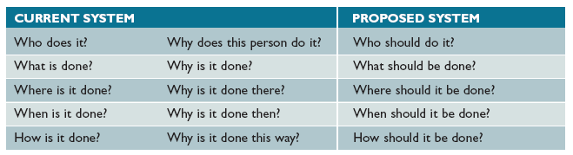
Fact Finding (Cont.)
FIGURE 4-17 Sample questions during requirements modeling as the focus shifts from the current system to the proposed system

